Slide 1
Portland Metro Area Car Crashes
Thomas Sato

Slide 2
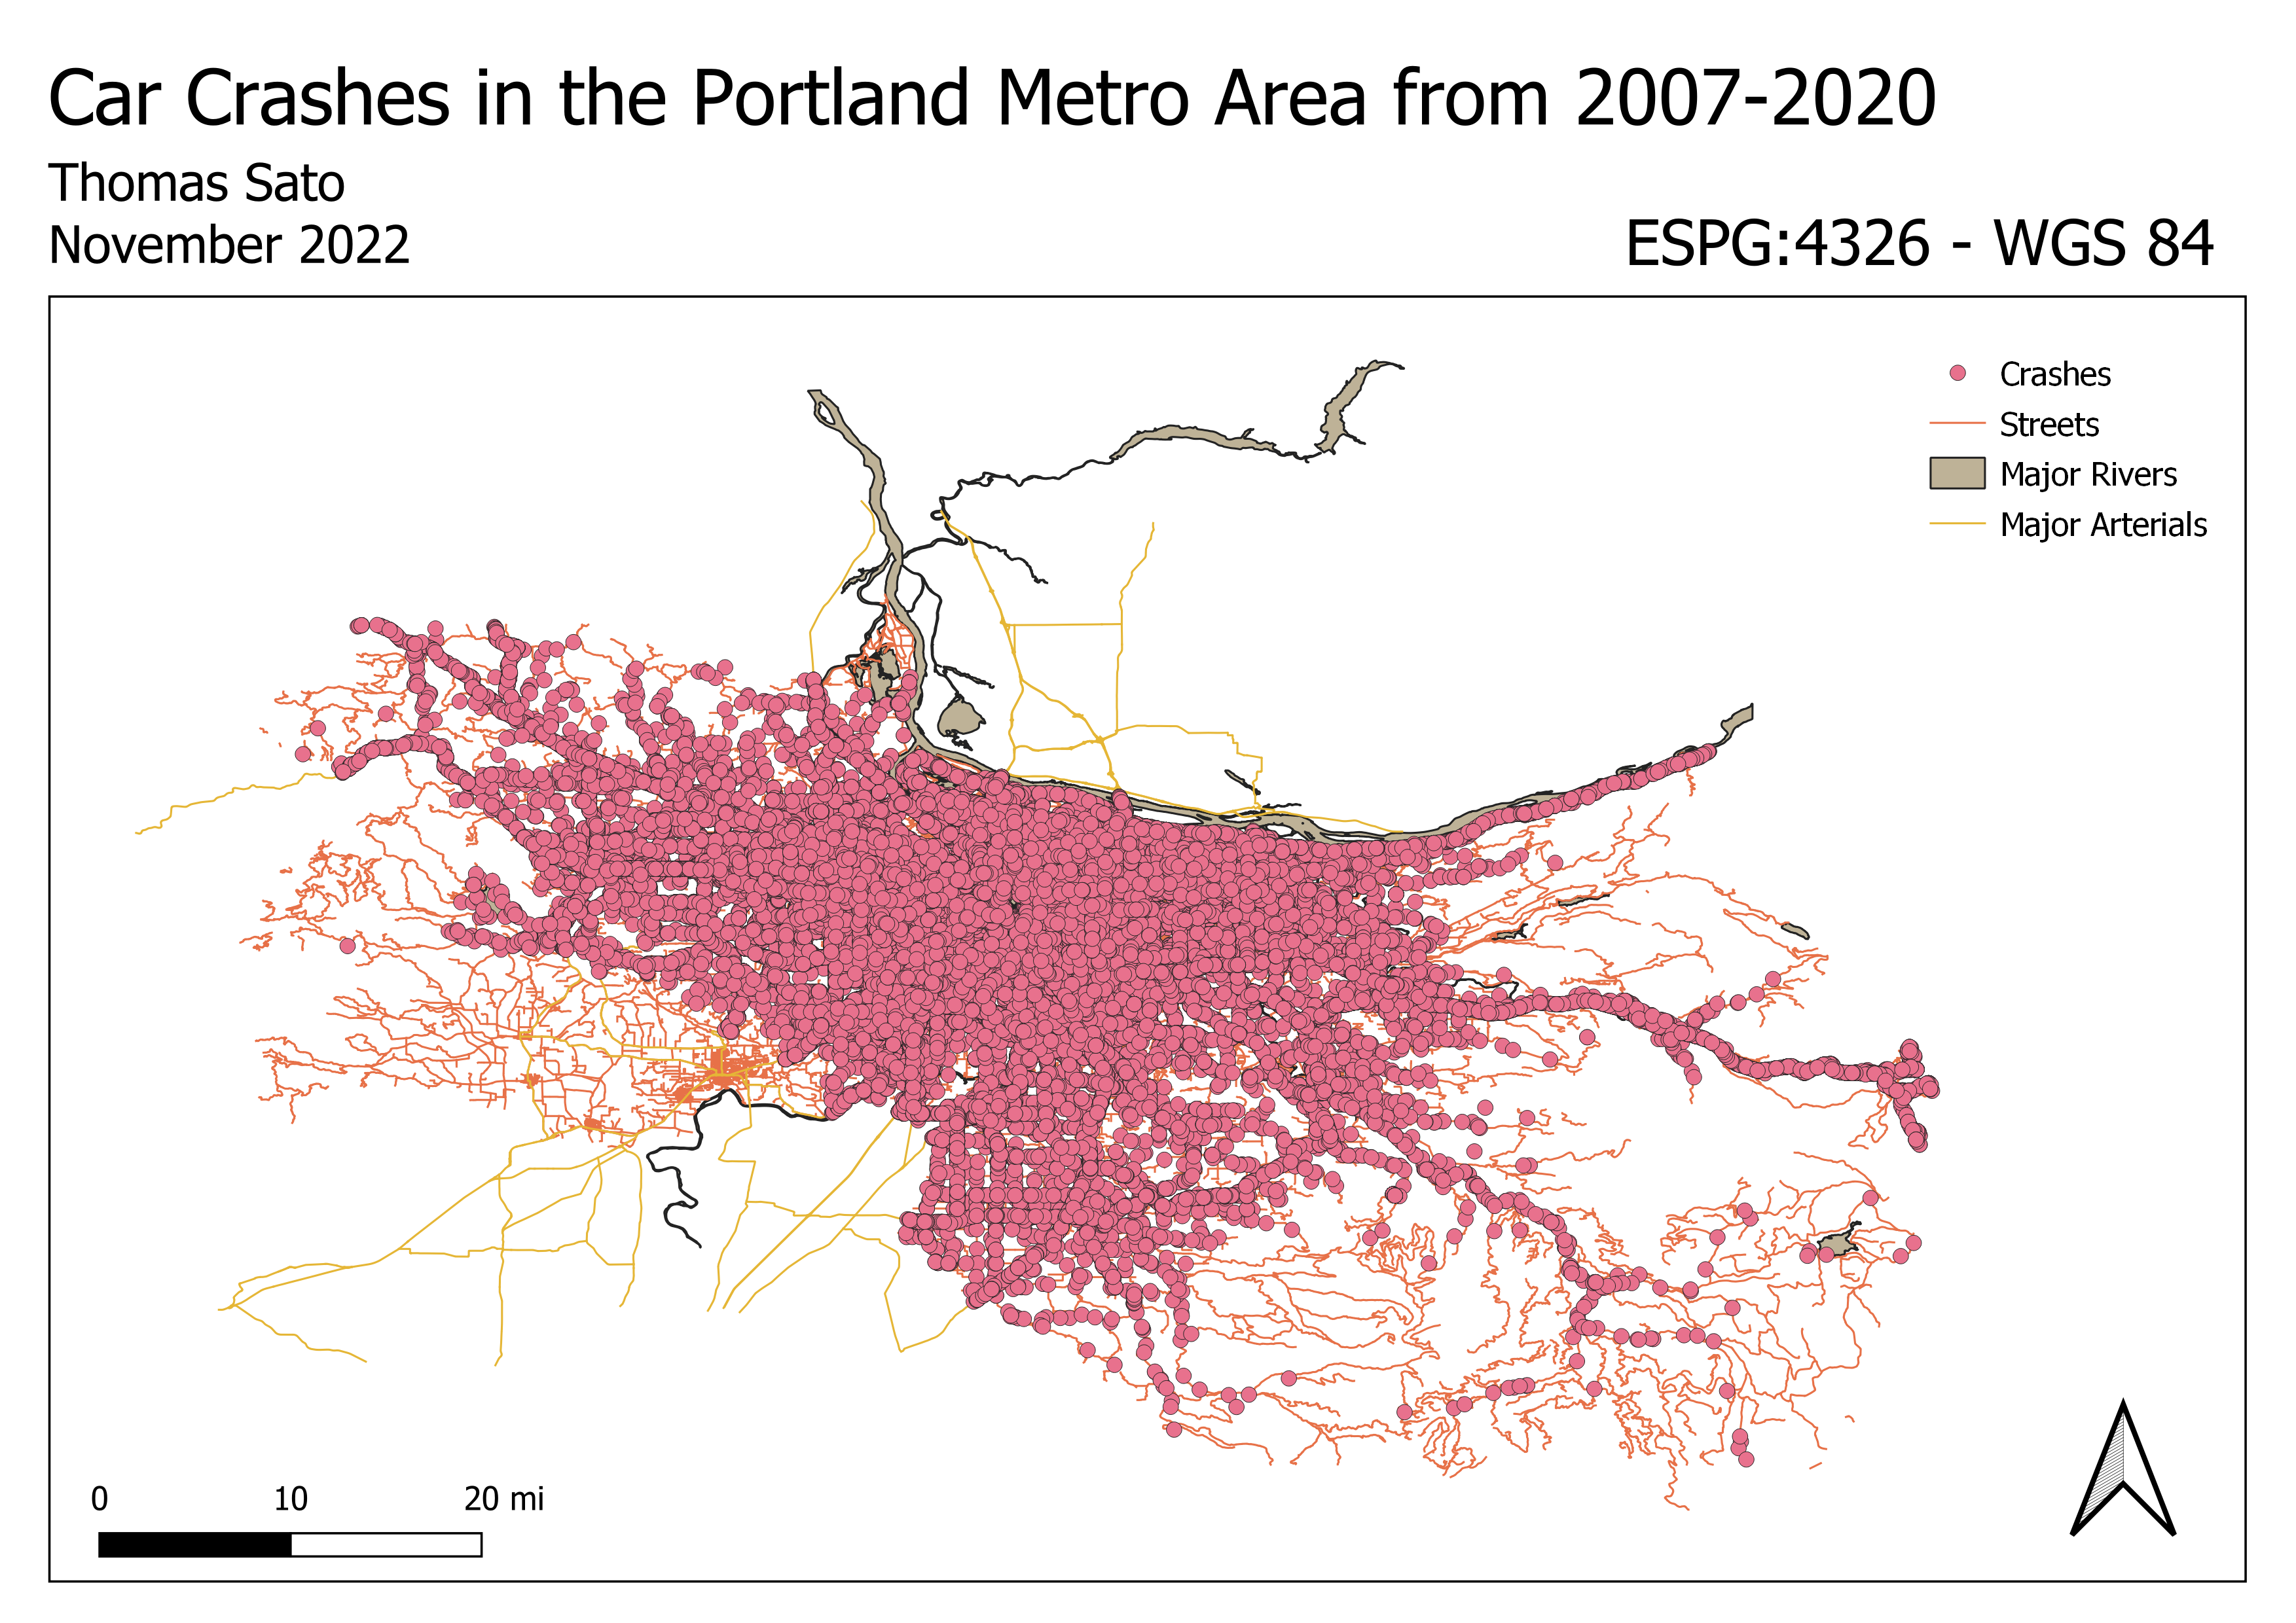
Introduction and Motivation
People get into car crashes
Huge dataset from RLIS!
321,829 car crashes from 2007 – 2020
149 attributes

Slide 3
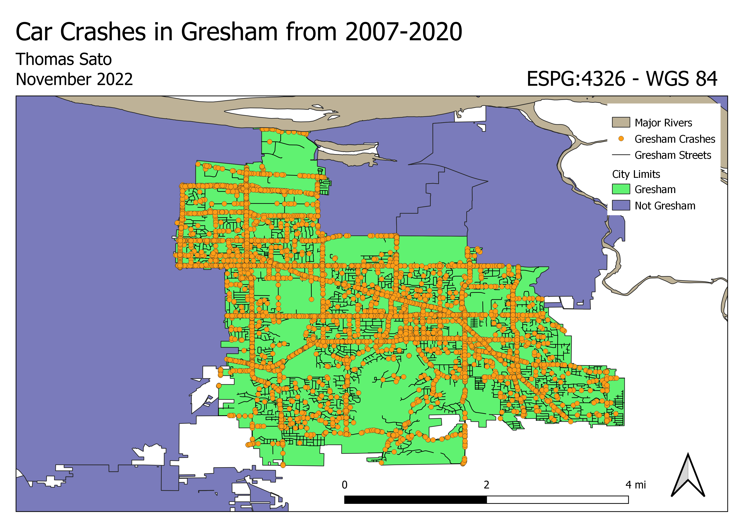
Problem Statement
Identify high-density clusters
Discover any relationships between attributes in the data
Potentially model/visualize some results using statistical programming
Wanted to look at my hometown

Slide 4
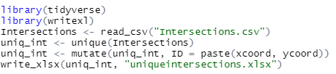
Methods
Step 1: Point vector file w/ every intersection
Line Intersection Tool
Export to R to filter out duplicate values
Import to QGIS

Slide 5
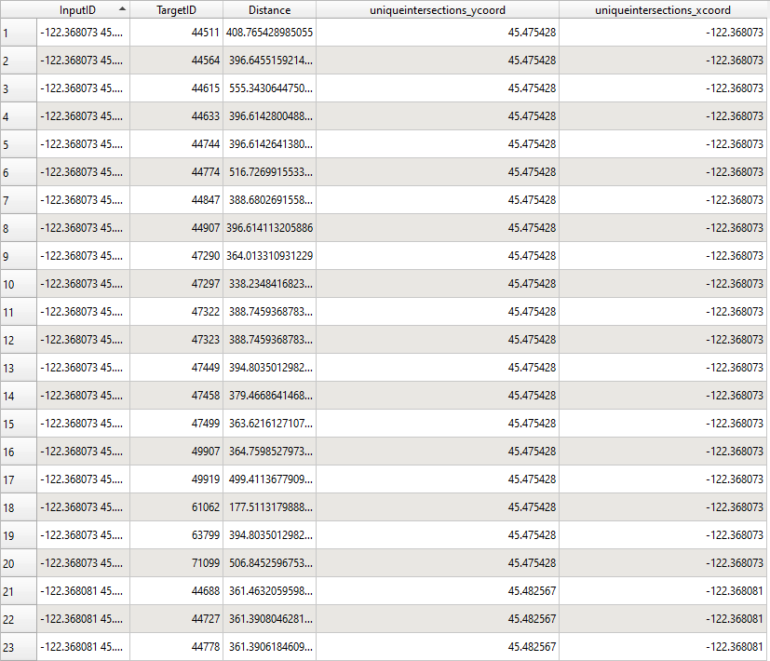
Methods
Step 2: Find proximity of each intersection to car crashes
Distance Matrix Tool
Used k = 20 car crashes
Table join unique coordinates

Slide 6
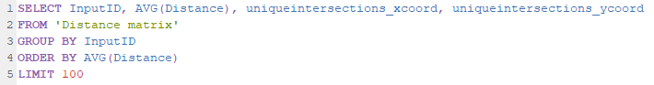
Methods
Step 3: Find average distance between each crash and intersection
SQL Database Manager
Export to CSV then back to point vector file

Slide 7
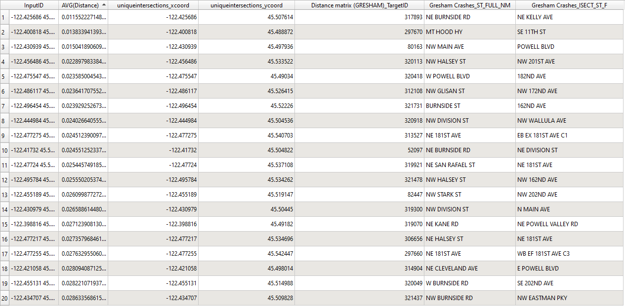
Results
Step 4: Identify Intersections (More Table Joins)

Slide 8
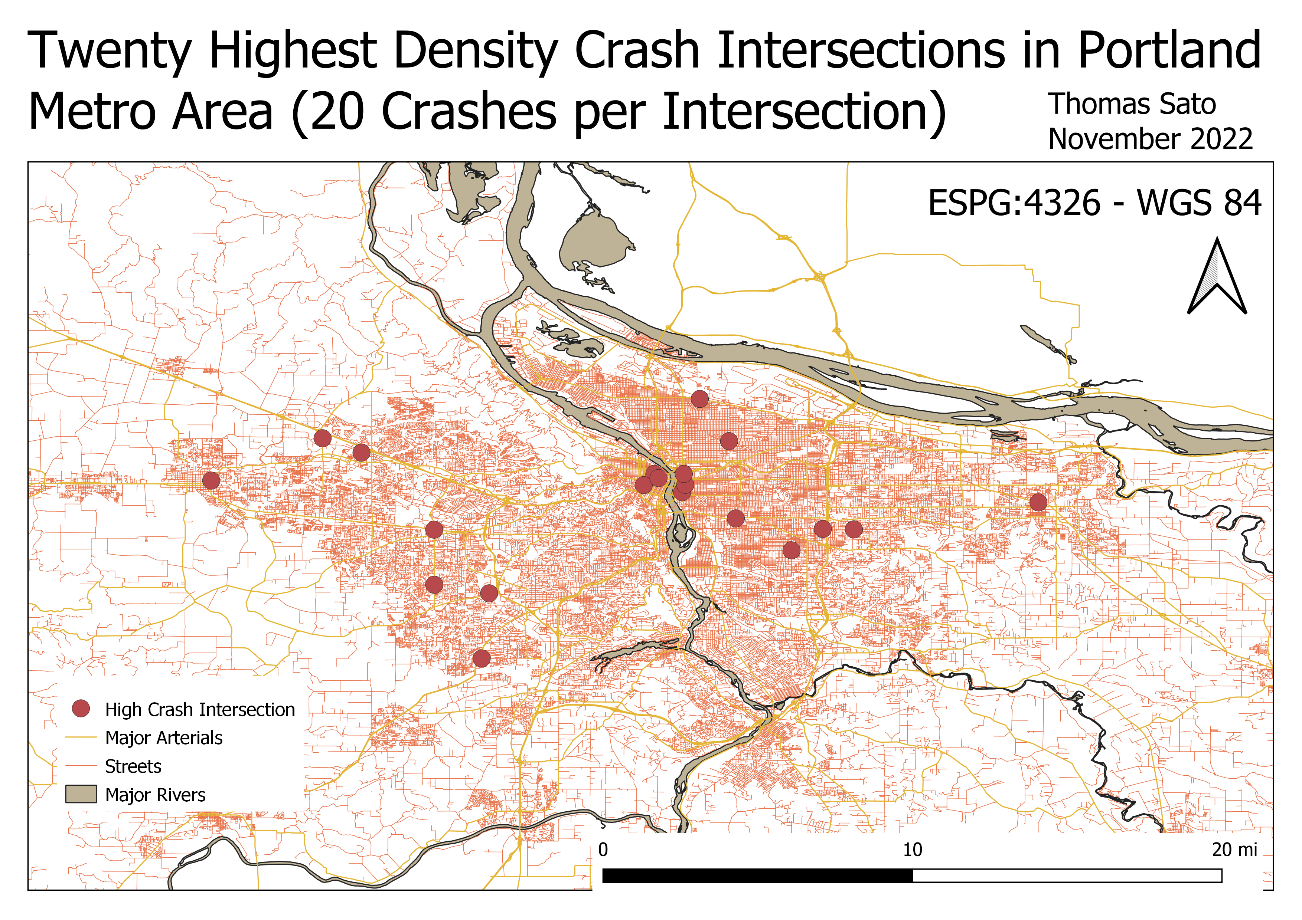
Results/Discussion

Slide 9
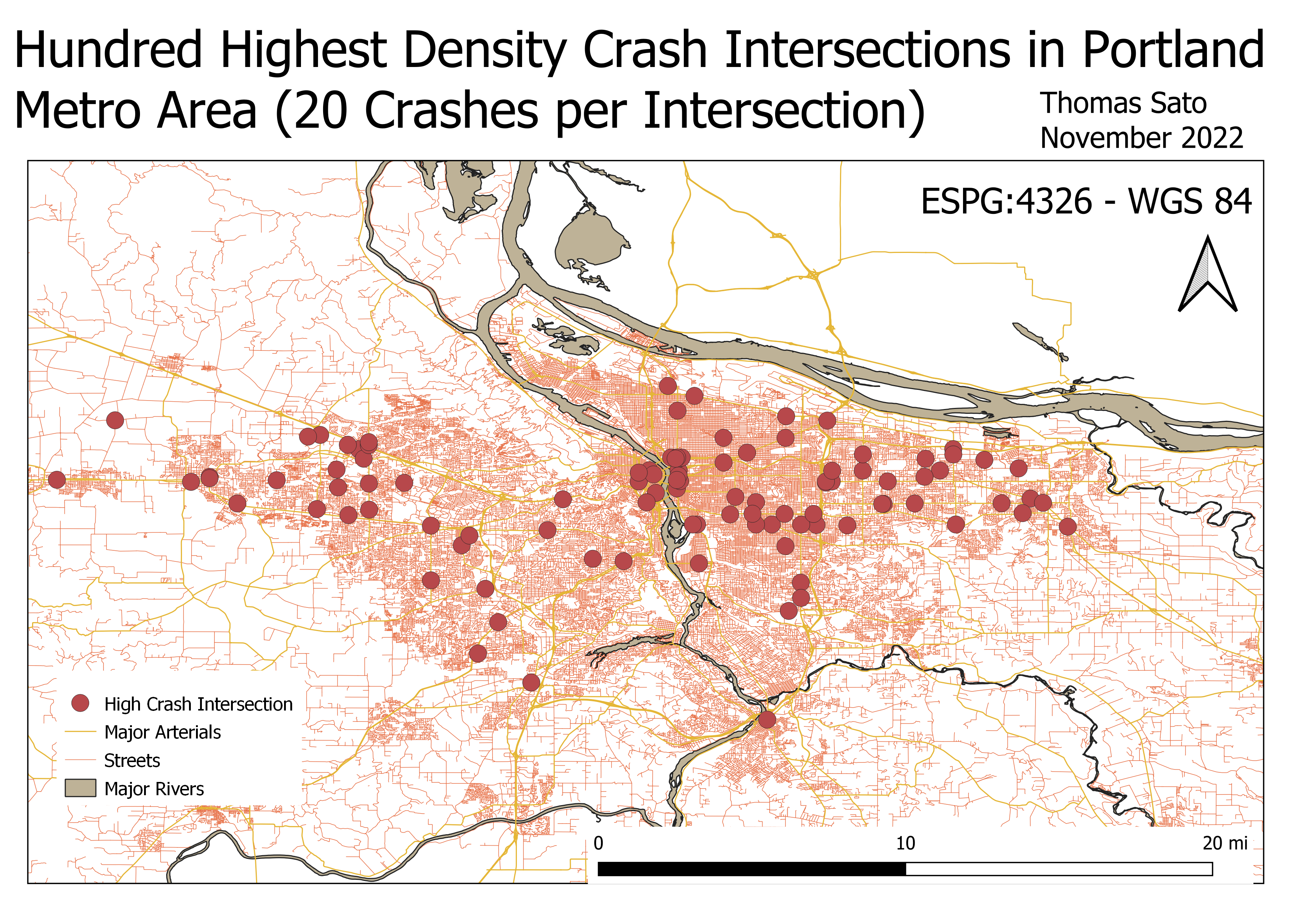
Results/Discussion

Slide 10
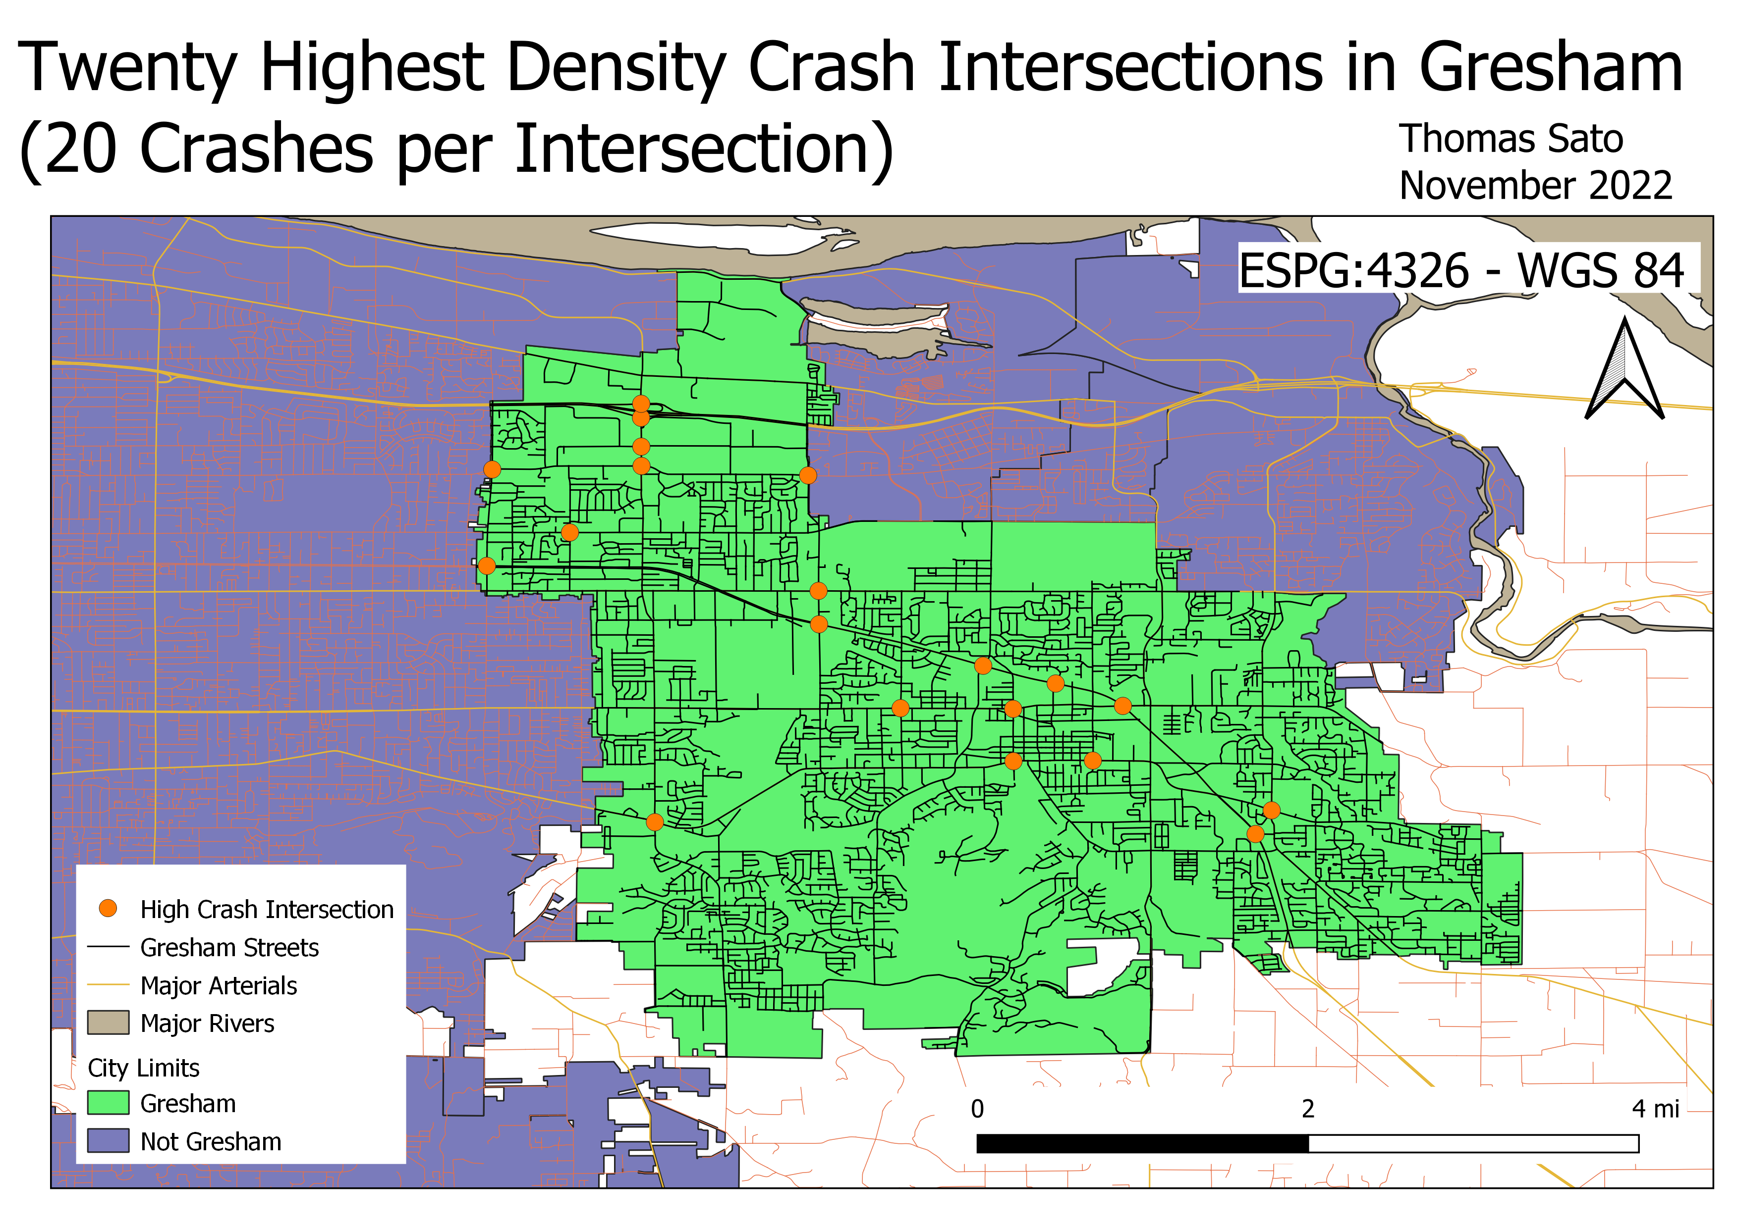
Results/Discussion

Slide 11
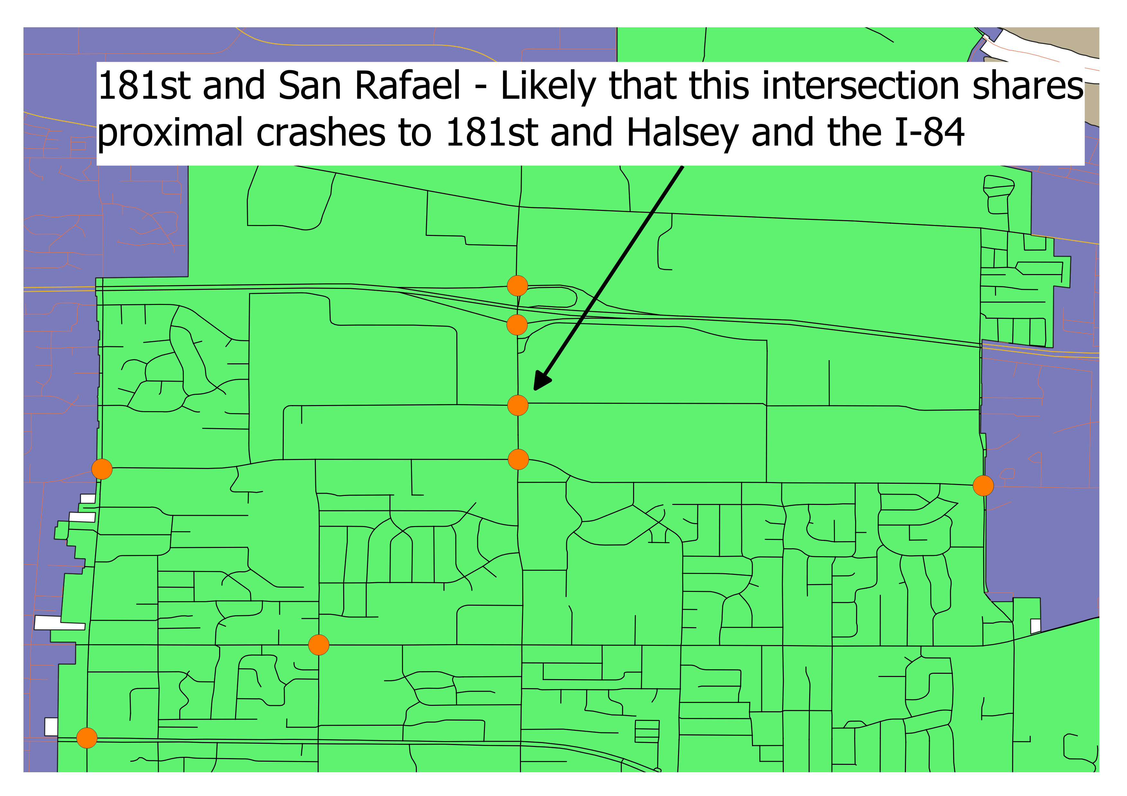
Implications, Conclusions, Future Work
Somewhat of a start to a transportation problem
Places for improvement:
Units that go along with the distance matrix
Potential clustering of high-crash intersections due to proximity to crashes in other intersections
Future Work:
Field work
A lot more cool stuff you can do with the
dataset

Slide 12
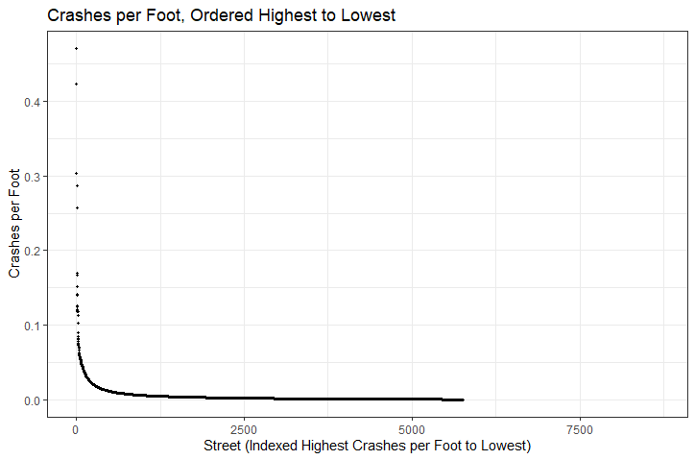
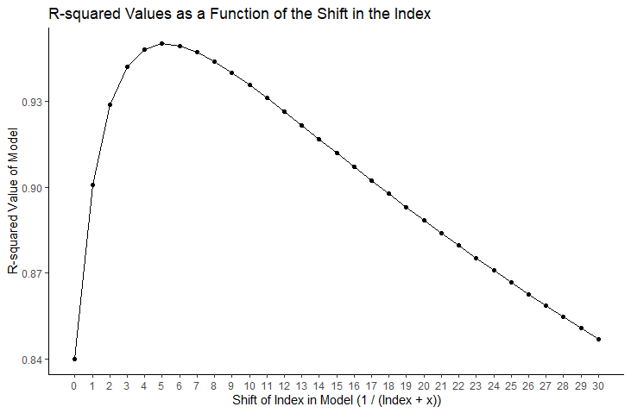
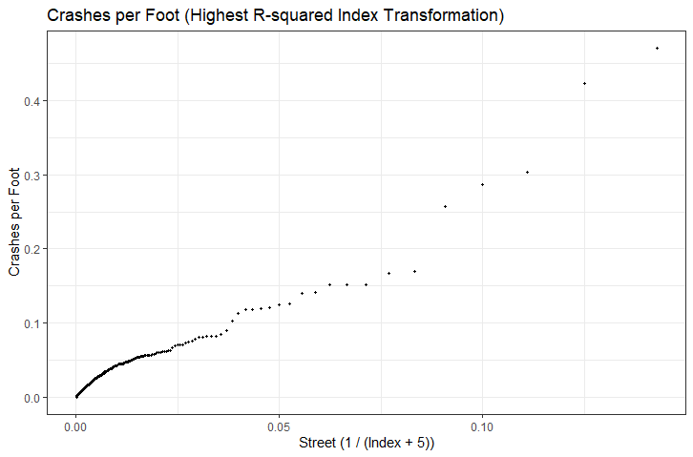
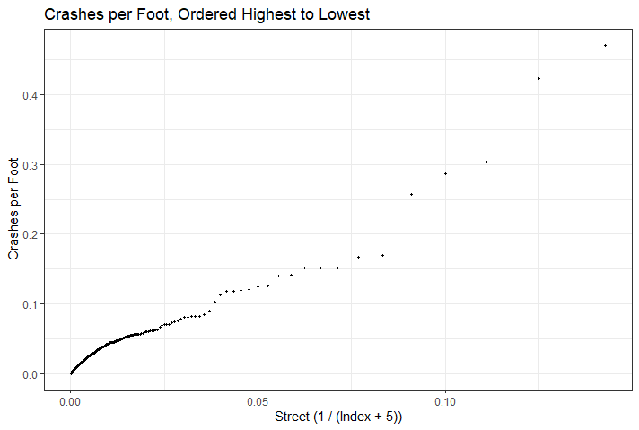
Interesting Graphs

Slide 13
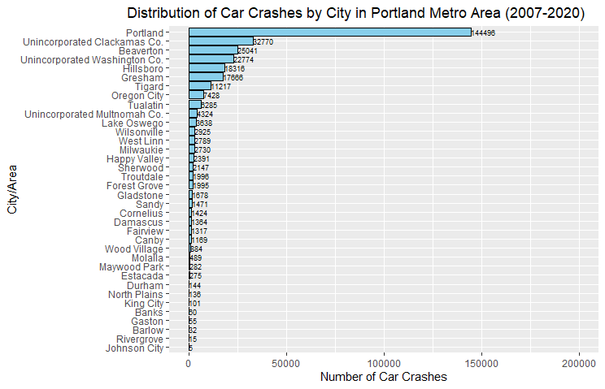
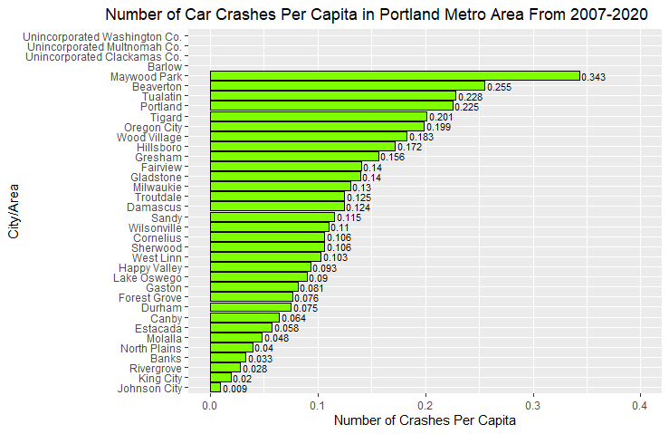
Interesting Graphs

Slide 14
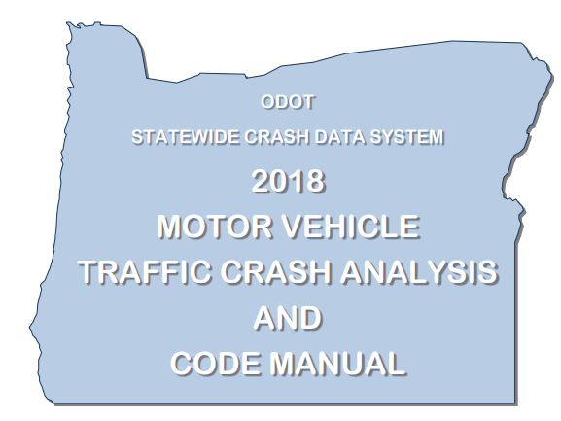
Citations
All data gathered from Oregon Metro Regional Land Information System:
https://rlisdiscovery.oregonmetro.gov/
And their 310 pages of metadata for the dataset:
https://www.oregon.gov/odot/Data/documents/CDS_Code_Manual.pdf

